Slide 1

BITS, PILANI – K. K. BIRLA GOA CAMPUS
Operating Systems
(IS ZC362)
by
Mrs. Shubhangi Gawali
Dept. of CS and IS
BITS, PILANI – K. K. BIRLA GOA CAMPUS

Slide 2


Slide 3
Parent process create children processes, which, in turn create other processes, forming a tree of processes
Generally, process identified and managed via a process identifier (pid)
Resource sharing
  Parent and children share all resources
  Children share subset of parent’s resources
  Parent and child share no resources
Execution
  Parent and children execute concurrently
  Parent waits until children terminate

Slide 4
Address space
  Child duplicate of parent
  Child has a program loaded into it
UNIX examples
  fork system call creates new process
  exec system call used after a fork to replace the process’ memory space with a new program

Slide 5
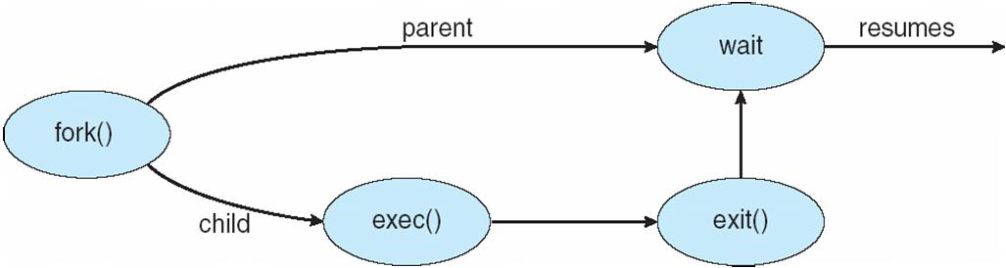

Slide 6

If fork() returns a negative value, the creation of a child process was unsuccessful.
fork() returns a zero to the newly created child process.
fork() returns a positive value, the process ID of the child process, to the parent.

Slide 7
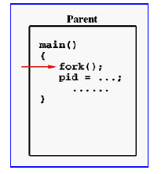

Notes:
If the call to fork() is executed successfully, Unix will
make two identical copies of address spaces, one for the parent and the other for the child.
Both processes will start their execution at the next statement following the fork() call. In this case, both processes will start their execution at the assignment statement as shown.

Slide 8
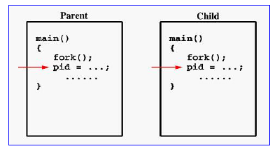
Notes:
Both processes start their execution right after the system call fork(). Since both processes have identical but separate address spaces, those variables initialized before the fork() call have the same values in both address spaces. Since every process has its own address space, any modifications will be independent of the others. In other words, if the parent changes the value of its variable, the modification will only affect the variable in the parent process's address space. Other address spaces created by fork() calls will not be affected even though they have identical variable names.

Slide 9
#include <stdio.h> #include <sys/types.h> void ChildProcess(void); void ParentProcess(void); void main(void) { pid_t pid; pid = fork(); if (pid == 0) ChildProcess(); else ParentProcess(); } | void ChildProcess(void) { int i; for (i =1; i<= 10; i++) printf(“child, i=%d\n", i); printf(“child done \n"); } | void ParentProcess(void) { int i; for (i=1; i<= 10; i++) printf(“parent, i= %d\n", i); printf(“parent done\n"); }
Notes:
In this program, both processes print lines that indicate (1) whether the line is printed by the child or by the parent process, and (2) the value of variable i. For simplicity, printf() is used.

Slide 10
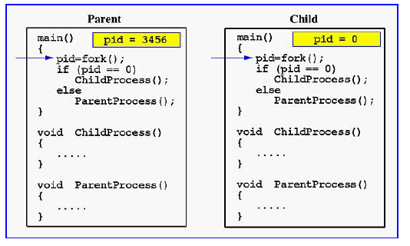
Notes:
When the main program executes fork(), an identical copy of its address space, including the program and all data, is created. System call fork() returns the child process ID to the parent and returns 0 to the child process. The following figure shows that in both address spaces there is a variable pid. The one in the parent receives the child's process ID 3456 and the one in the child receives 0.

Slide 11
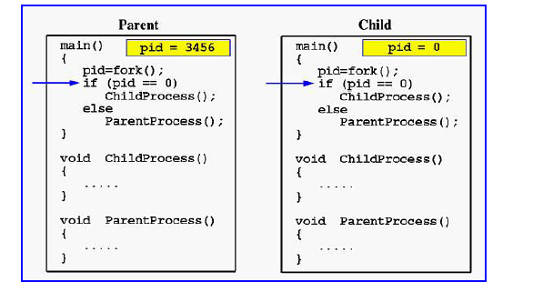
Notes:
Now both programs (i.e., the parent and child) will execute independent of each other starting at the next statement:

Slide 12
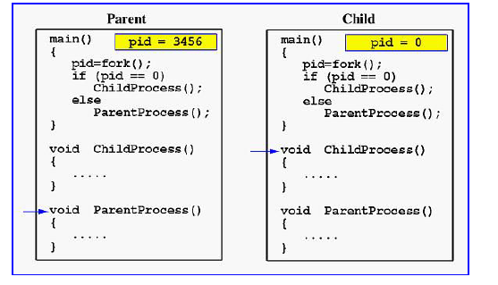
Notes:
In the parent, since pid is non-zero, it calls function ParentProcess(). On the other hand, the child has a zero pid and calls ChildProcess() as shown.
Due to the fact that these processes are run concurrently, their output lines are intermixed in a rather unpredictable way. Moreover, the order of these lines are determined by the CPU scheduler. Hence, if you run this program again, you may get a totally different result.
Due to the fact that the CPU scheduler will assign a time quantum to each process, the parent or the child process will run for some time before the control is switched to the other and the running process will print some lines before you can see any line printed by the other process.

Slide 13
#include <stdio.h>
#include <unistd.h>
#include <errno.h>
#include <sys/types.h>
int main(){
pid_t pid;
printf(“fork program starting \n”);
pid = fork();
if (pid < 0 ){ perror(“fork failed\n”); exit(1); }
else if (pid == 0){
printf(“ This is from child process My PID is %d and my Parent PID is %d\n”,getpid(),getppid()); }
else { printf(“This is from parent process My PID is %d and my Child’s PID is %d\n”,getpid(),pid); wait(NULL); } // common to parent and child
return 0;
}

Slide 14
Each process is allowed to have a unique number named process identifier or PID
  usually between 2 and 32767 (/proc/sys/kernel/pid_max)
  64 bit → maximum PID number up to 4194303
Next unused number is chosen as process ID
Once upper limit of 32767 is reached then the numbers restart at 2 so that they wrap around.
PID 1 is init process, Process 0 is swapper or sched (Process 0 is responsible for paging)
Process has its own code, data, stack, environment space, program counter etc.
Process table contains information about all the processes that are currently loaded with

Slide 15
fork
pid_t fork(void)
  Duplicates the current process, creating a new entry in the process table with many of the same attributes as the parent process.
  The new process is almost identical to the original, executing the same code but with its own data space, environment and file descriptor.
  Uses copy on write technique
  Kernel internally invokes do_fork() function (in fork.c)

Slide 16
The fork ( ) system call does the following in a UNIX system
  Allocates slot in the process table for the new process
  Assigns a unique process id to the new process
  Make a copy of the process image of the parent, with the exception of shared memory
  Increases counters for any files owned by the parent, to reflect that an additional process now also owns these files.
  Assigns the child process a ready state
  Returns the Process ID number (PID) of the child to the parent process and a 0 value to the child process.

Slide 17
  All this work is done in Kernel space of parent process
  After completing these functions, OS will do the following operations as a part of dispatcher routine
    Control returns to the user mode at the point of the fork call of the parent
    Transfer control to the child process. The child process begins executing at the same point in the code as the parent, namely at the return from the fork call
    Transfer control to another process. Both child and parent are left in the ready state
If fork system call fails, the return value to parent (no child will be created) will be -1

Slide 18
#include <stdio.h>
#include <unistd.h>
#include <errno.h>
#include <sys/types.h>
int main()
{
if(fork())
if(fork())
fork();
return 0;
}
P1
P2
P3
p4

Slide 19
#include <stdio.h>
#include <unistd.h>
#include <errno.h>
#include <sys/types.h>
int main()
{
printf(“fork program starting \n”);
if( fork( ))
if(!fork( ) )
fork( );
return 0;
}
P1
P2
P3
p4

Slide 20
#include <stdio.h>
#include <unistd.h>
#include <errno.h>
#include <sys/types.h>
int main()
{
if(!fork())
if(!fork())
fork();
return 0;
}
P1
P2
P3
p4

Slide 21
int x=0;
int main()
{
for(i=0;i<2;i++)
{
fork();
x=x+5;
}
return 0;
}
X = 10
P1
X = 10
P2
P3
X = 10
p4
X = 10
Number of new processes created is 3
Final value of x in P1 is 10
Final value of x in P2 is 10
Final value of x in P3 is 10
Final value of x in P4 is 10

Slide 22

The Unix process management model is split into two distinct operations :
The creation of a process.
The running of a new program.

Slide 23
The creation of a new process is done using the fork() system call.
A new program is run using the exec(l,lp,le,v,vp) family of system calls.
These are two separate functions which may be used independently.

Slide 24

A call to fork() will create a completely separate sub-process which will be exactly the same as the parent.
The process that initiates the call to fork is called the parent process.
The new process created by fork is called the child process.
The child gets a copy of the parent's text and memory space.
They do not share the same memory .

Slide 25

fork() system call returns an integer to both the parent and child processes:
-1 this indicates an error with no child process created.
A value of zero indicates that the child process code is being executed.
Positive integers represent the child’s process identifier (PID) and the code being executed is in the parent’s process.

Slide 26

if ( (pid = fork()) == 0)
printf(“I am the child\n”);
else
printf(“I am the parent\n”);

Slide 27

Process 0 is created by the system boot code.
All other processes are created by the fork system call.
After a fork, both parent and child processes resume execution at the return of the fork function.
The child process contains copies of the parent's text, data, and stack segments. The child process has file descriptors that contains references to the same opened files as its parent, so they both share the same file pointer to each opened file.

Slide 28

When the child process calls exec(), all data in the original program is lost, and it is replaced with a running copy of the new program.
Calling one of the exec() family will terminate the currently running program and starts executing a new one which is specified in the parameters of exec in the context of the existing process.
The process id is not changed.
If the exec command fails, then it returns 1.

Slide 29

Using exec, an executable binary file (eg: a.out) can be converted into a process.
An example of using exec is implementing a shell program or a command interpreter.
A shell program takes user commands and executes them.

Slide 30

int execl( const char *path, const char *arg, ...);
int execlp( const char *file, const char *arg, ...);
int execle( const char *path, const char *arg , ..., char * const envp[]);
int execv( const char *path, char *const argv[]);
int execvp( const char *file, char *const argv[]);

Slide 31
The first difference in these functions is that the first four take a pathname argument while the last two take a filename argument. When a filename argument is specified:
• if filename contains a slash, it is taken as a pathname.
• otherwise the executable file is searched for in the directories specified by the PATH environment variable.

Slide 32

execl- takes the path name of a binary executable as its first argument, the rest of the arguments are the command line arguments ending with a NULL.
Example: execl("./a.out", NULL)

Slide 33

execv – takes the path name of a binary executable as its first argument, and an array of arguments as its second argument.
Example: static char* args[] = {“ “, "cat.txt", "test1.txt", NULL};
execv("/bin/cp", args);
The empty string “ “ can be replaced by the command itself (eg “ls”) or leave it as “ “.

Slide 34

execlp - same as execl except that we don’t have to give the full path name of the command.
Example: execlp("ls", NULL)

Slide 35


Slide 36


Slide 37

When a program wants to have another program running in parallel, it will typically first use fork, then the child process will use exec to actually run the desired program.

Slide 38

wait, waitpid - wait for a child process to stop or terminate
#include <sys/wait.h>
pid_t wait(int *status);
pid_t waitpid(pid_t pid, int *status, int options);
  It pause / suspends the parent process until one of its child processes is exited or until a signal is delivered whose action is to terminate the parent or child process or to call a signal handling function.
It returns the PID of the child and the exit status gets placed in status.
To prevent the child becoming a zombie the parent should call wait on its children, either periodically or upon receiving the SIGCHLD signal, which indicates a child process has terminated.

Slide 39
If a child has already exited by the time of the call, the function returns immediately and system resources used by the child are freed.
The call returns the PID of the child process (when child process terminates) on success.
The status information allows the parent process to determine the exit status of the child process. i.e the value returned from main or passed by exit.
If status is not a null pointer, the status information will be written to the location to which it points.

Slide 40
In waitpid() the value of pid can be
< -1 which means to wait for any child process whose process group ID is equal to the absolute value of pid.
-1 which means to wait for any child process; this is the same behavior which wait exhibits.
0 which means to wait for any child process whose process group ID is equal to that of the calling process.
> 0 which means to wait for the child whose process ID is equal to the value of pid.

Slide 41

int main() {
int child_status, pid, pidwait;
if ((pid = fork()) == 0) {
printf(“This is the child!\n”);
}
else {
pidwait = wait(&child_status);
printf(“child %d has terminated\n”, pidwait);
}
return 0;
}

Slide 42
else if (pid == 0) {
printf(“ This is from child process I am exiting\n”);
exit(2);
}
else {
printf(“This is from parent process\n”);
}
wait(&status);
// waitpid(pid, &status,0);
// Child is no more and this part is only for Parent
printf(“Child exited already now with exit status %d\n”,status); return 0;
}
#include <stdio.h>
#include <unistd.h>
#include <errno.h>
#include <sys/types.h>
#include <sys/wait.h>
int main()
{
pid_t pid;
int status;
printf(“fork program starting \n”);
pid = fork();
if (pid < 0 ){
perror(“fork failed\n”); exit(1);
}

Slide 43
#include <stdio.h>
#include <unistd.h>
#include <sys/types.h>
#include <sys/wait.h>
int main()
{ printf("fork program starting with pid %d\n",getpid());
fork();
fork();
printf("My PID=%d My PPID = %d\n",getpid(),getppid());
wait(NULL);
wait(NULL);
return 0;
}

Slide 44
#include <stdio.h>
#include <unistd.h>
#include <sys/types.h>
#include <sys/wait.h>
int main()
{ int i;
printf("fork program starting with pid %d\n",getpid());
for(i=0;i<2;i++)
fork();
printf("My PID=%d My PPID = %d\n",getpid(),getppid());
while(wait(NULL)!= -1);
return 0;
}

Slide 45

System function exit allows termination of a process.
Prototype :
        #include <stdlib.h>
        void exit(int status);
The value of the status may be EXIT_SUCCESS(0), EXIT_FAILURE(1) or any
other value that is available to a parent process.

Slide 46

Process related Commands
The process related system calls in UNIX include fork( ), exec( ) [many variations of this], wait( ) and exit( ) system calls.
Using exec, an executable binary file (eg: a.out) can be converted into a process.

